Slide 1

Team R4 – Ghost Trawler
Progress report and goals

Slide 2
Major Project Components
3D printed CAD model
ROS system on Nvidia Jetson Nano
System management PCB

Slide 3

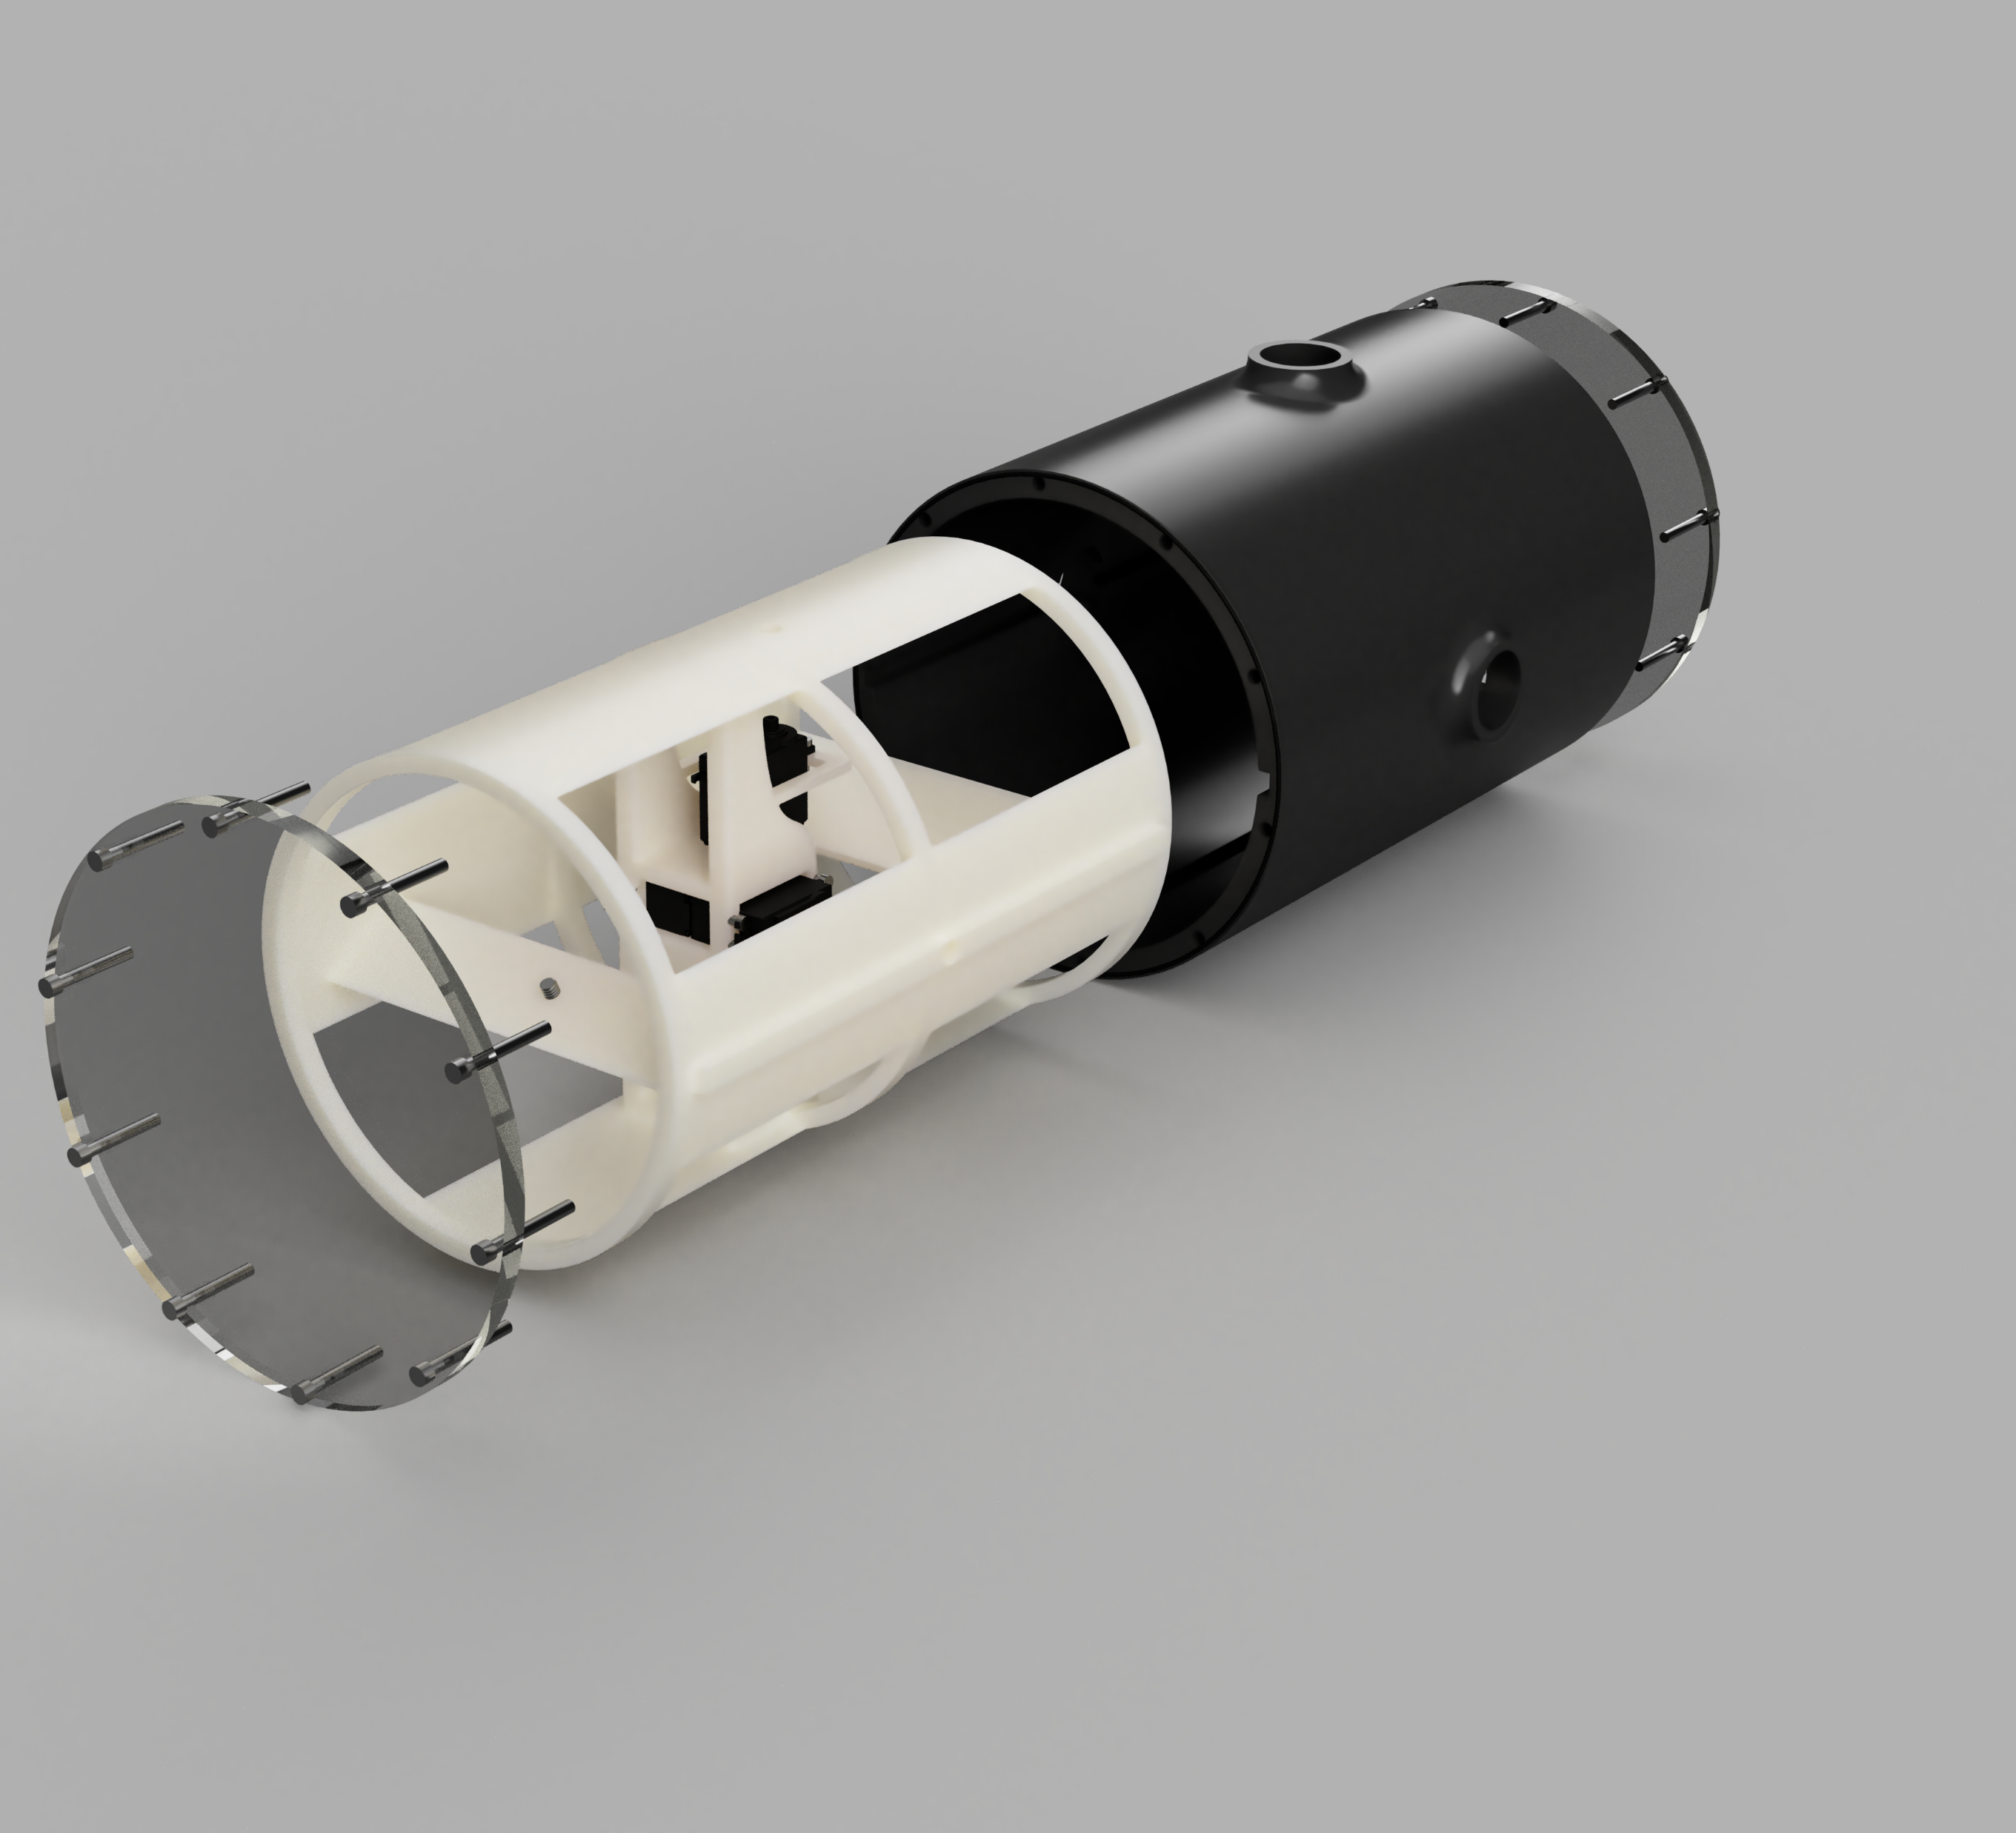
3D printed CAD model
Major milestones:
Sketch system model
Full CAD model
Extensive hardware list
3D print
Assembly

Slide 4
ROS system on Nvidia Jetson Nano
Major milestones
Download, install, and setup ROS framework
Write navigation and controller
Simulation and PID tuning
Assembly

Slide 5
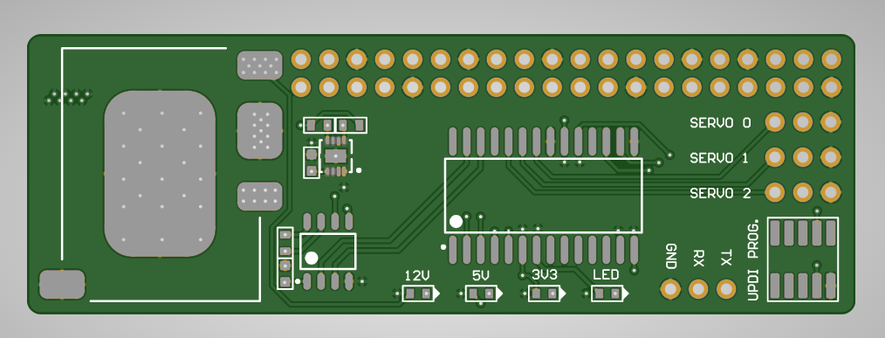
System management PCB
Major milestones
Decide circuit requirements
Design and order PCB and BOM
Write Program for on-board AVR microcontroller
Solder PCB
Upload and test Program
Assembly

